Slide 1
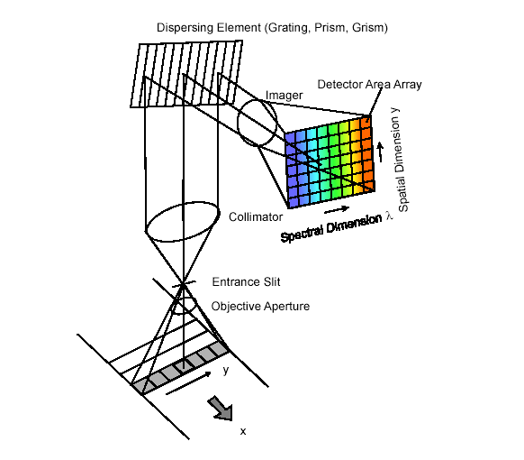
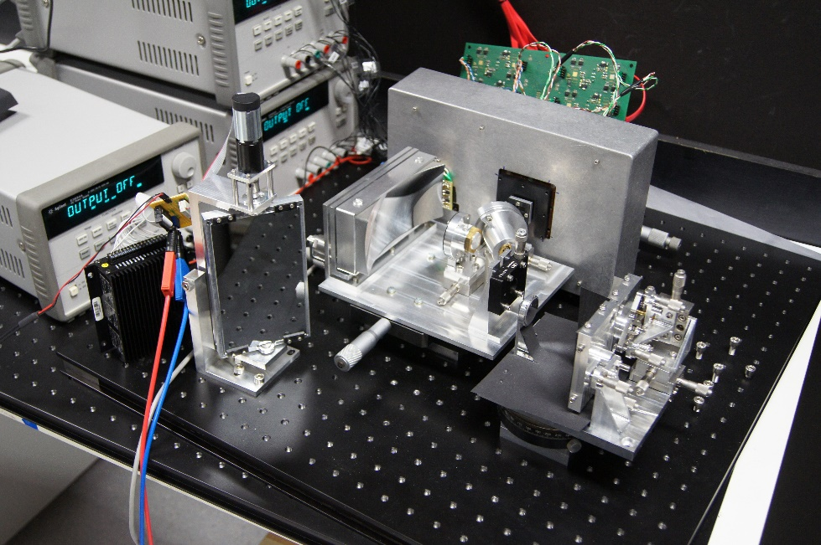
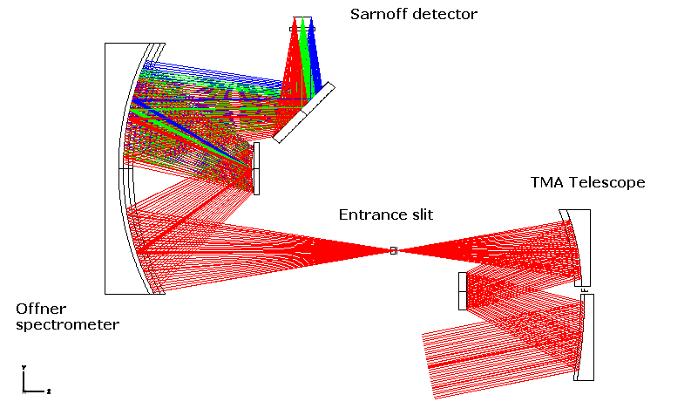
Schemat działania spektrometrów push-broom
Scheme of the prototype of Hyperspectral spectrometer for UAV working in push-broom mode
Laboratory model

Slide 2
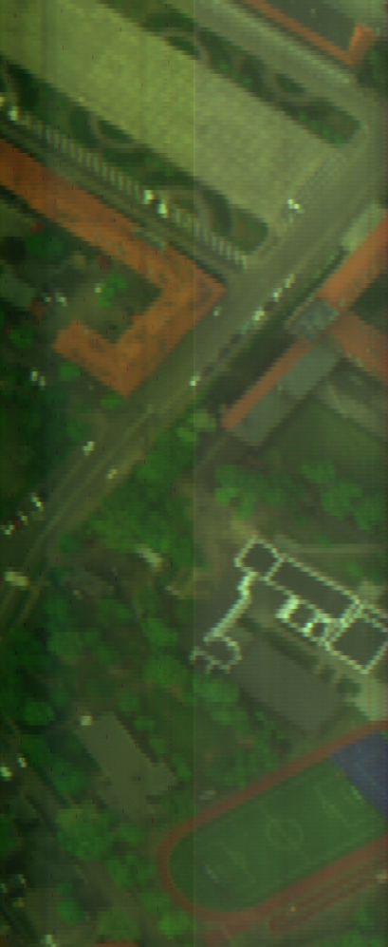
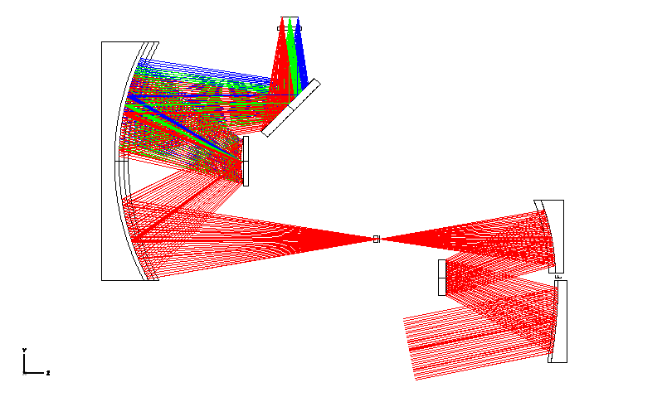
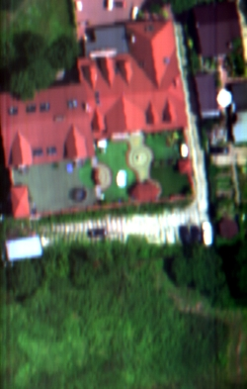
Hyperspectral spectrometer
Hyperspectral spectrometer for UAV & small aeroplane, working in push-broom mode. Technical parameters:
Spectral range: 0,4-1,0 μm,
Spectral resolution: 2 – 13 nm,
FoV: 15 deg,
Speed of data acquisition: 20Gb/sec,
Mass less than: 4 kg.

